Slide 1
OpenGL Basics
koliber

Slide 2
What is OpenGL ? ( Open Graphics Library )
Cross-language, Cross-Platform API for rendering 2D, 3D vector graphics.
The API is typically used to interact with a graphics processing unit (GPU), to achieve hardware-accelerated rendering.
Drivers: the people who make GPUs, are responsible for writing implementations of the OpenGL rendering system. Their implementations, commonly called "drivers“ , translate OpenGL API commands into GPU commands

Slide 3
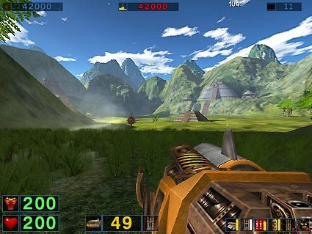

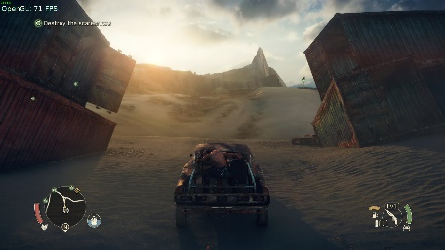
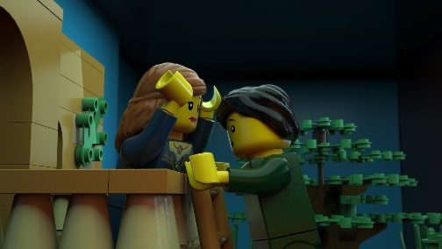
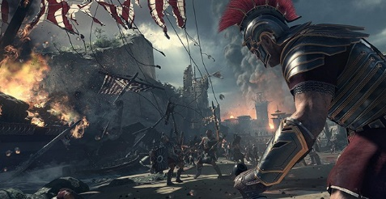

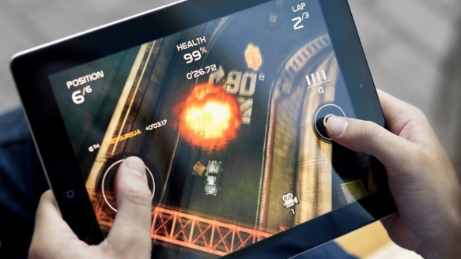
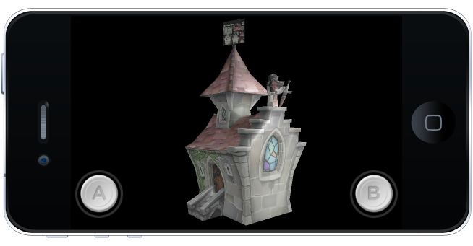
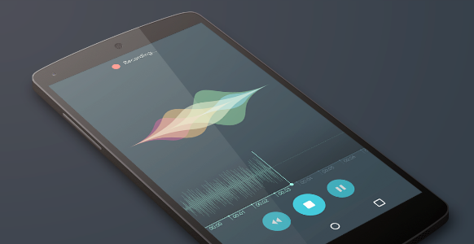
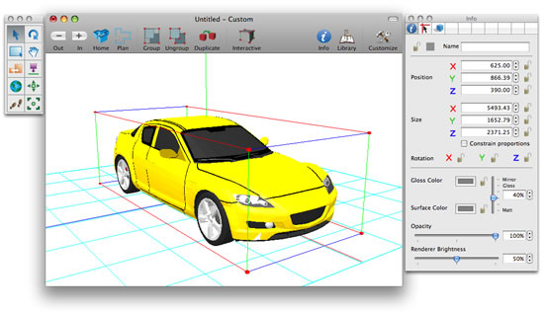
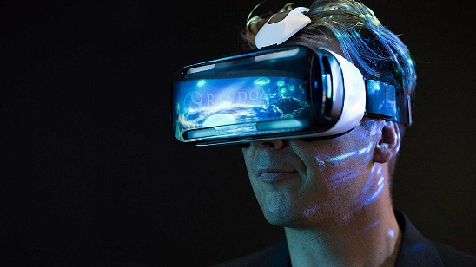
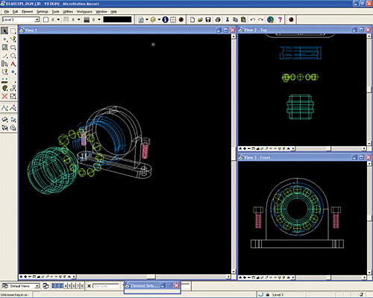
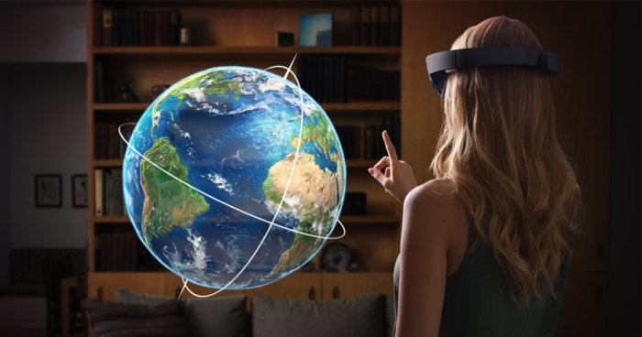
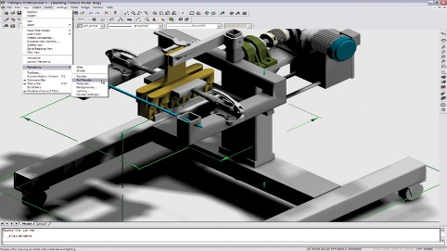
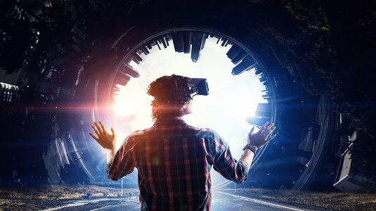
OpenGL usages
Games
Animations and Videos
Mobile phones
CAD (Computer Aided Design )
virtual reality

Slide 4
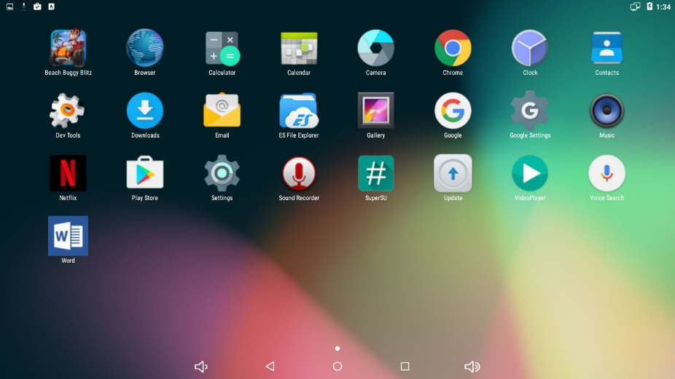
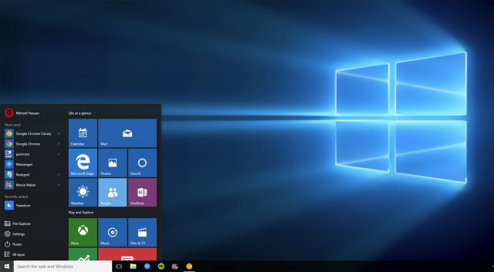
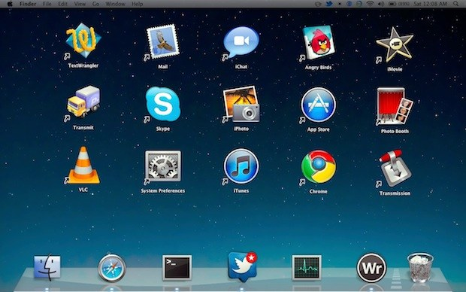
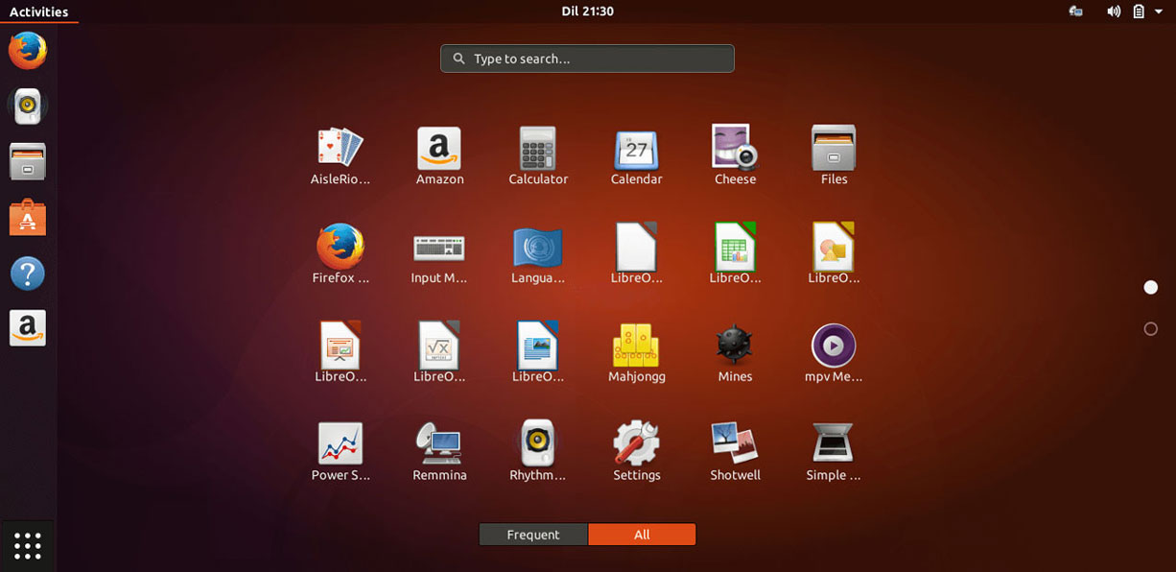
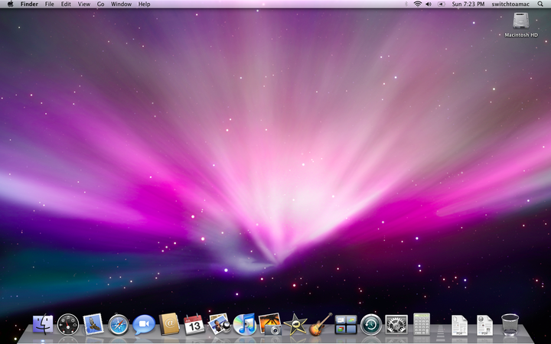
OpenGL platforms
Embeded Devices (OpenGLES)
Desktop Operation Systems
(OpenGL)

Slide 5
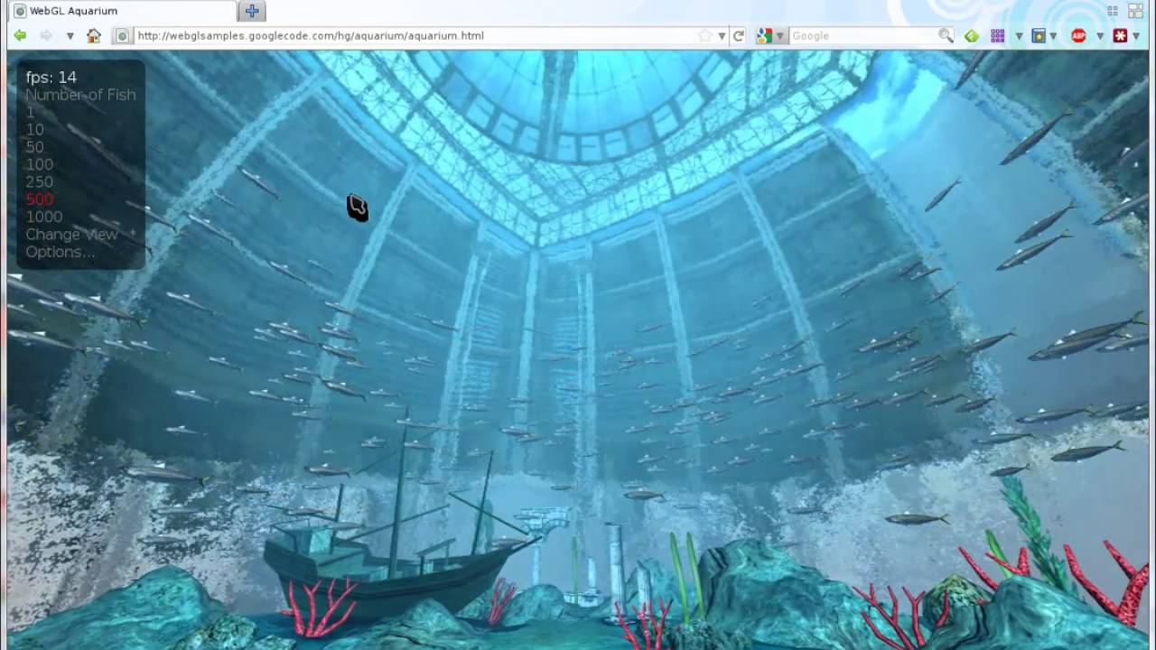
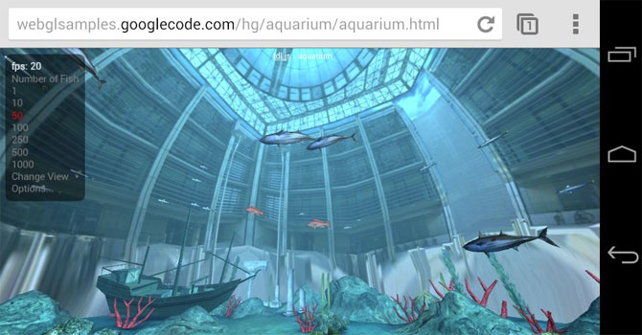
OpenGL platforms
Web based(WebGL)

Slide 6
OpenGL history
1991: Development started by SGI (Silicon Graphics INC. – ARB group (IBM , Microsoft , Nvidia , … ))
1992: OpenGL 1.0 launched (fixed functions/pipeline - legacy)
2000: OpenGL/ES 1.0 launched (embedded systems)
2004: OpenGL 2.0 released (programmable pipeline - GLSL/ shaders)
2005: OpenGL/SC 1.0 launched (safety critical)
2006: OpenGL 2.1 released (last release by SGI - to Khronos Group)
2008: OpenGL 3.0 released (first release by Khronos)
2016: Vulkan 1.0 launched (by Khronos – low driver overhead)
2017: OpenGL 4.6 released (last release by Khronos)

Slide 7
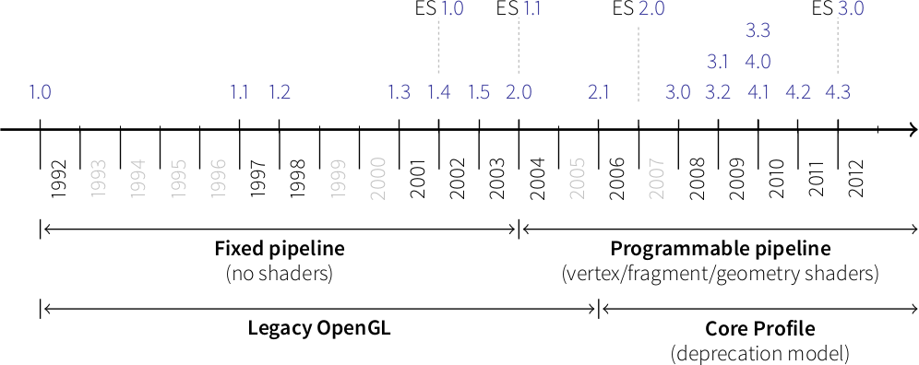
OpenGL history

Slide 8
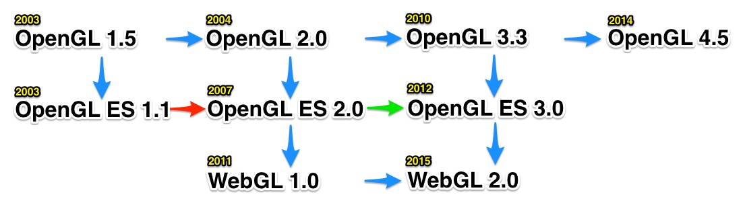
OpenGL history

Slide 9
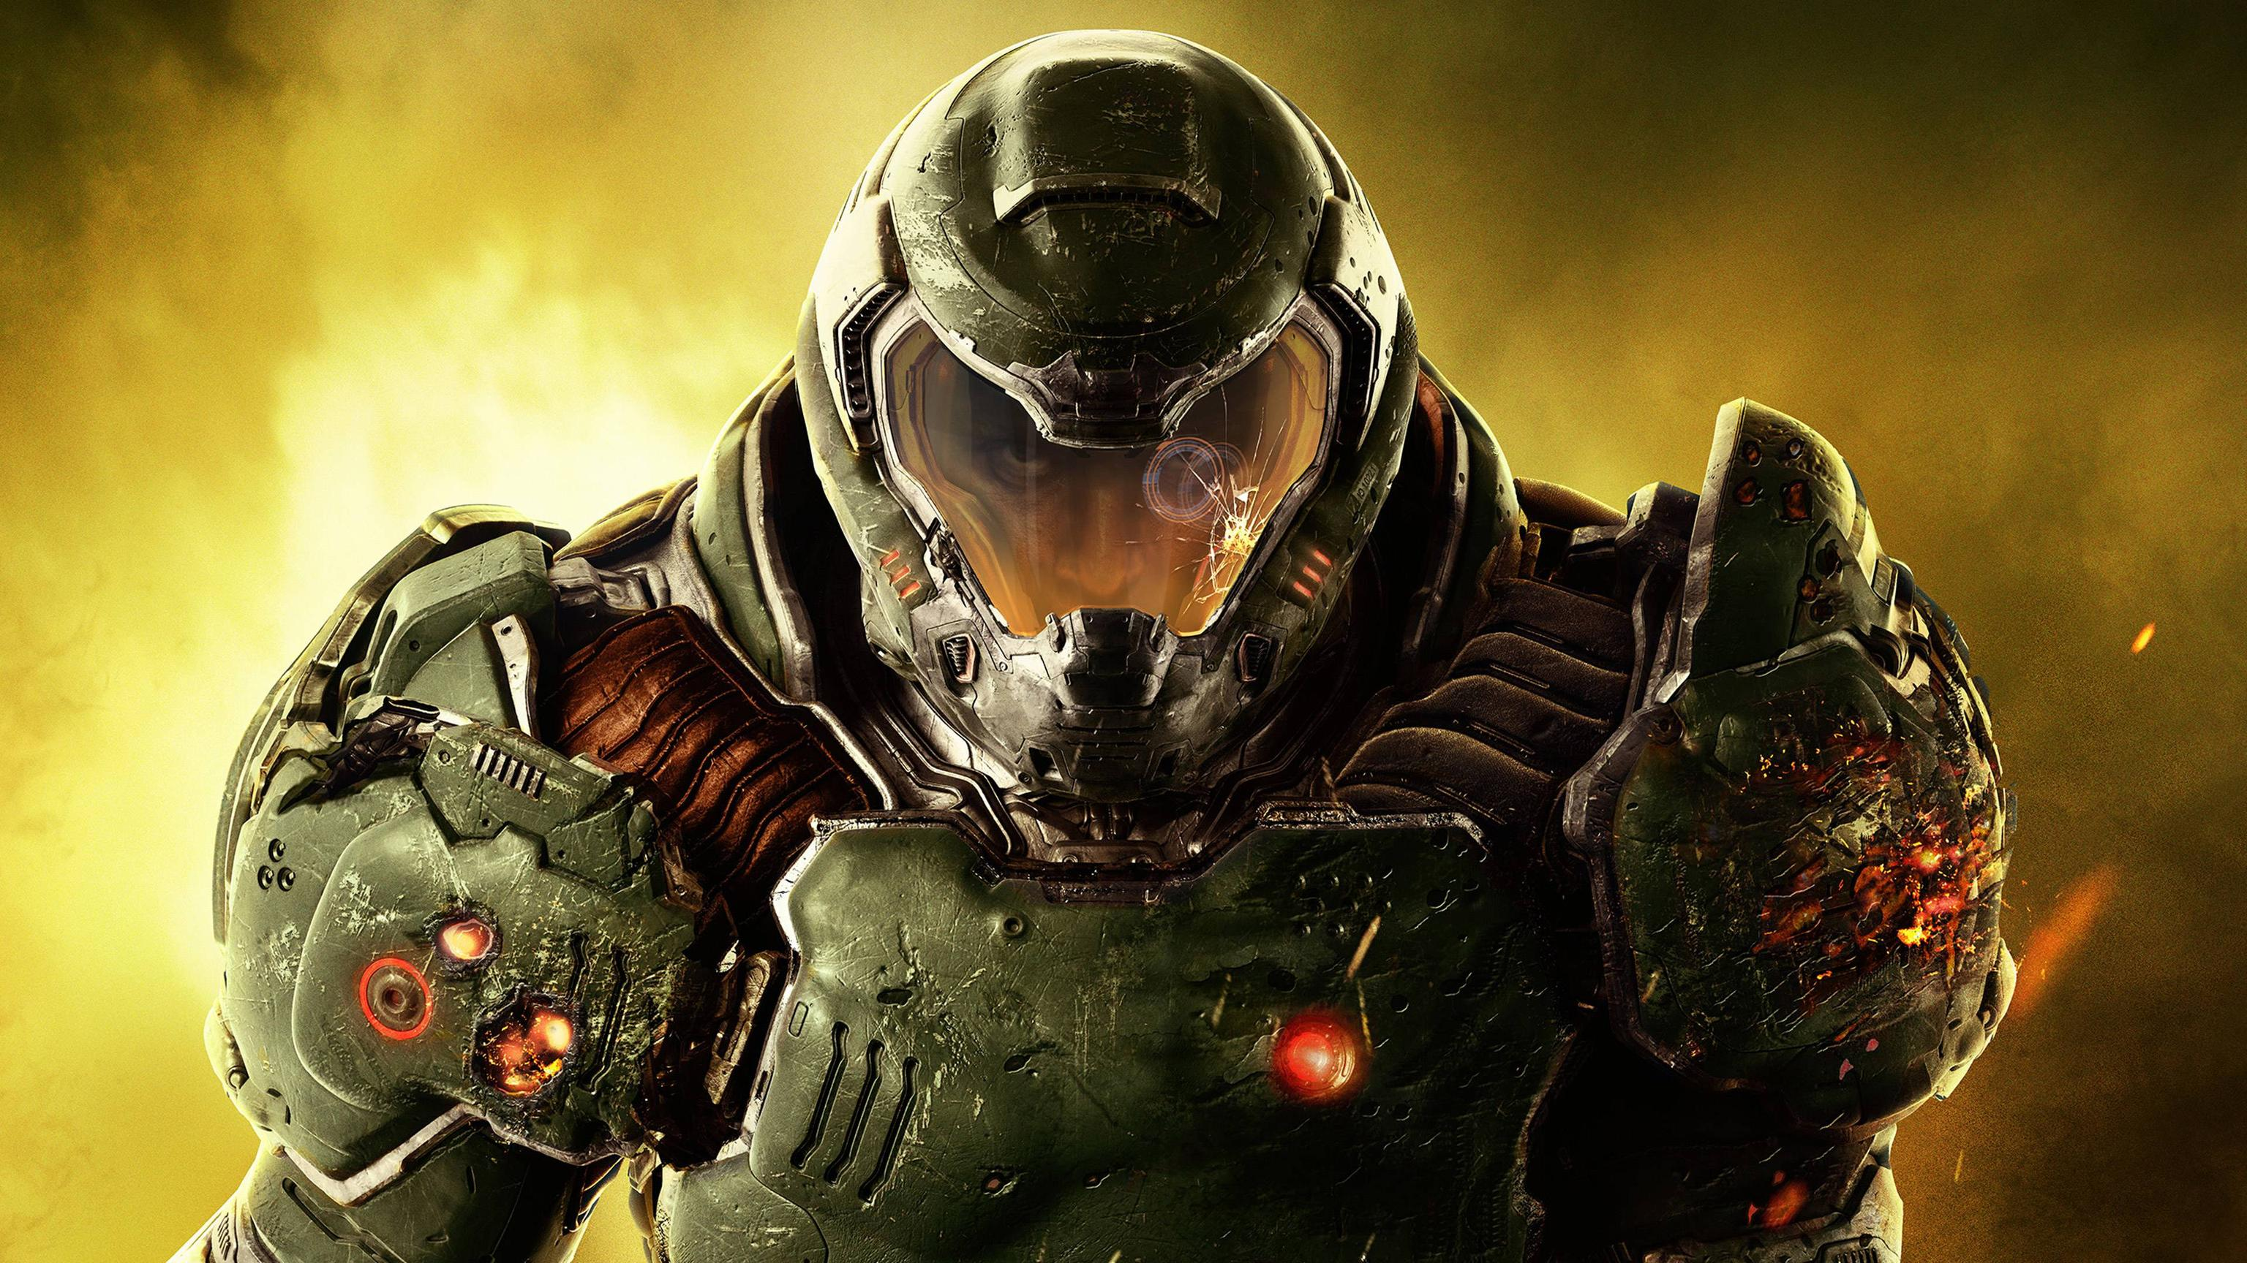
Deep into base !

Slide 10
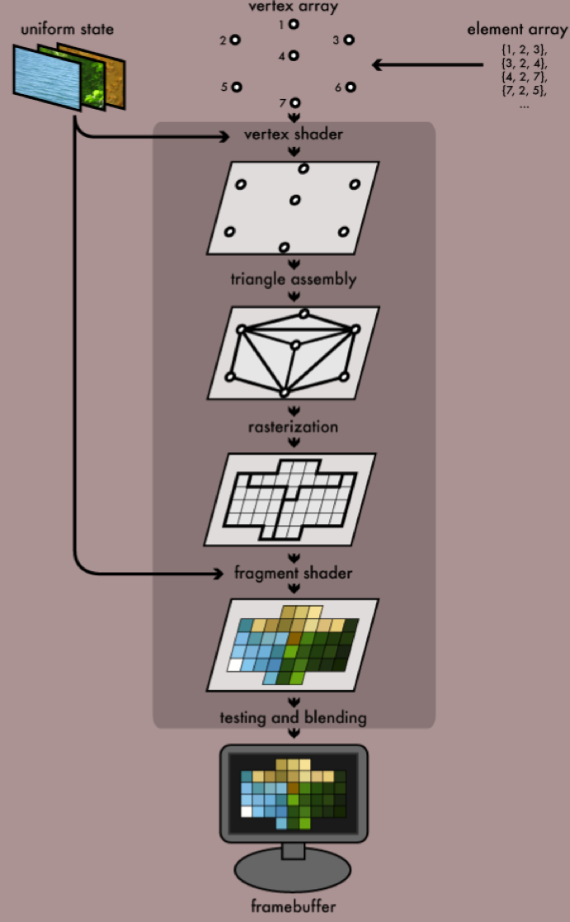
OpenGL rendering pipeline
At the first level OpenGL gets vertex array of our model and our texture coordinates or ( color and coordinates )
At the second level OpenGL will translate , rotate , scale our vertices based on the transformation and perspective matrices ( position calculator )
At the third level OpenGL assembles our vertices into triangles based on primitive type
At the fourth level OpenGL rasterizes our triangles into pixel format based on view port matrices and
At the fifth level OpenGL will colorize and texturize our pixels ( called fragment shader or pixel shader ) ( color chooser )
At the sixth level OpenGL will test our pixels and do some blending operations and at the end will write pixels into framebuffer for showing in display

Slide 11
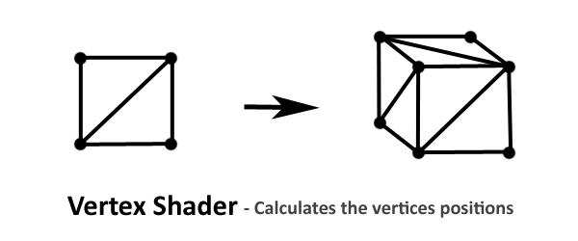
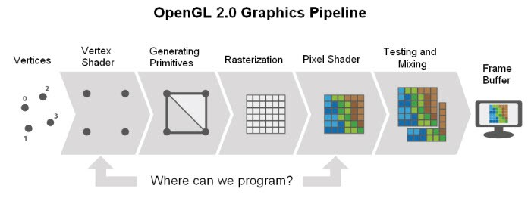
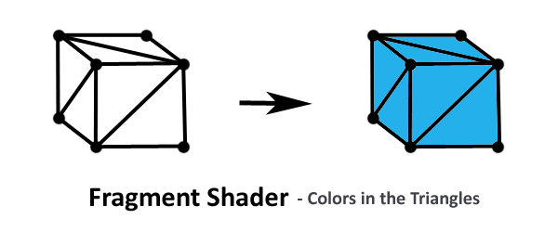
OpenGL rendering pipeline (Vertex/Fragment shader)
Vertex shader ( position calculator )
Another simple view of OpenGL pipeline
Fragment shader (color chooser )

Slide 12
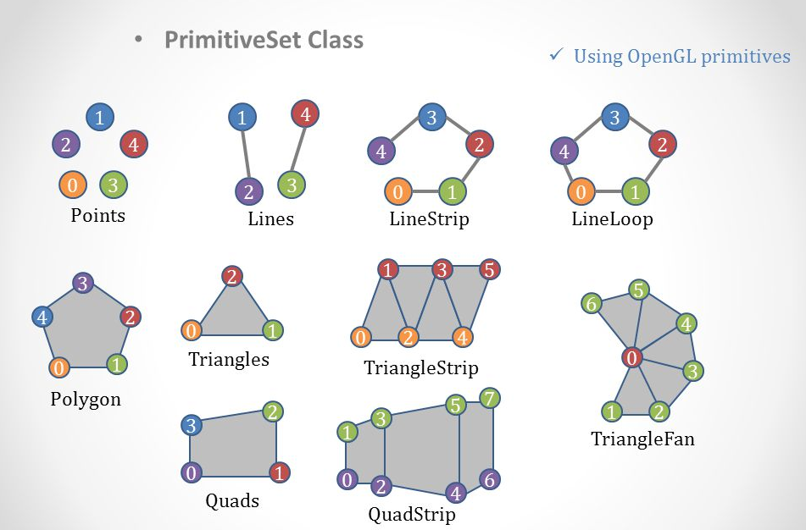
OpenGL rendering pipeline (Triangle assembling)
Primitive types for triangle assembling at level two

Slide 13
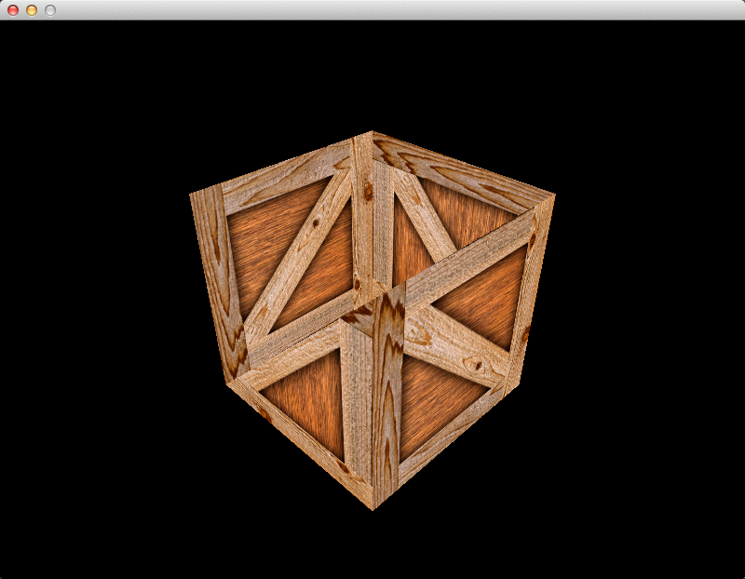
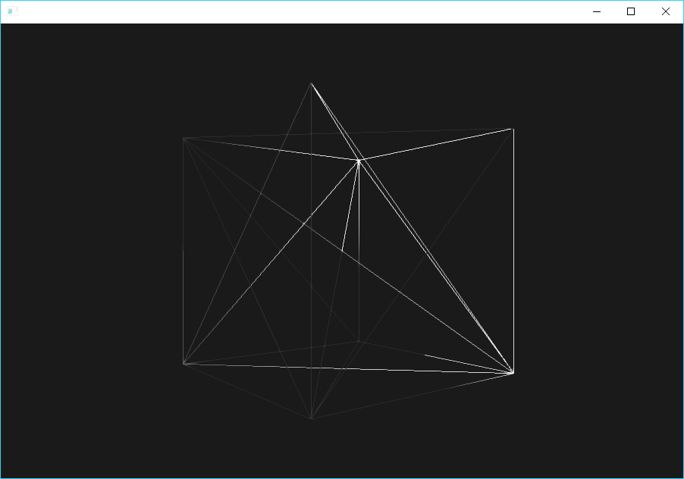
OpenGL rendering pipeline (Testing) – OpenGL/SC

Slide 14
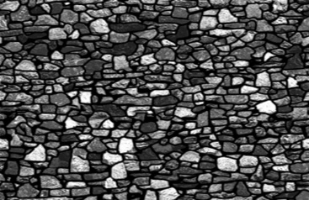
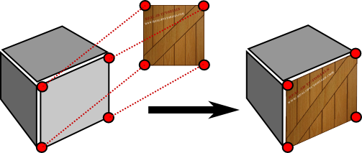
An important question ! (Texture mapping)

Slide 15
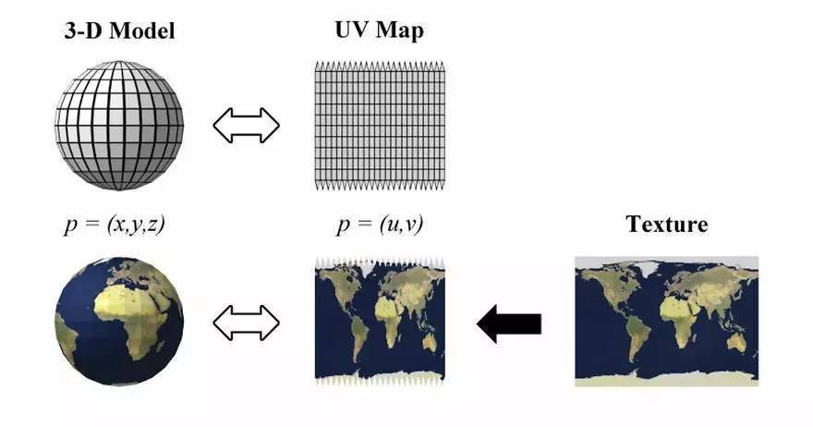
An important question ! (Texture mapping)
OpenGL texture mapping

Slide 16
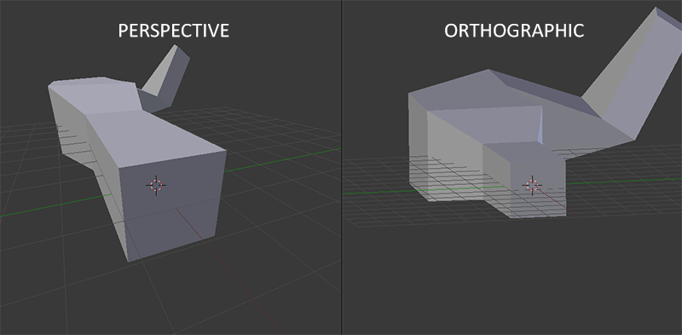
OpenGL rendering pipeline (Vertex shader – Projection)

Slide 17
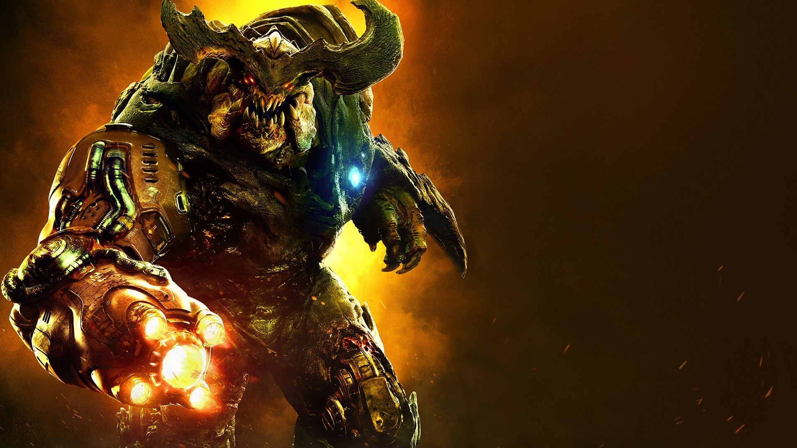
Deep into Vertex Shader!

Slide 18
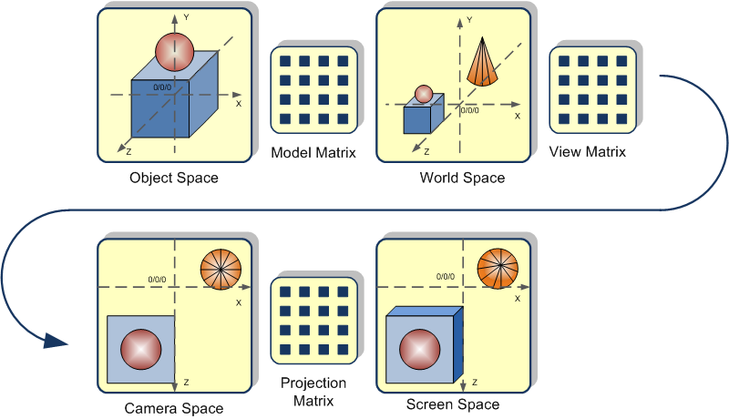
Vertex Shaders (MVP)
Model Matrix: Per model (Model position)
View Matrix: Camera position
Projection Matrix: Camera projection (Orthographic, Perspective, …)
ModelView Matrix: Old versions of OpenGL (View*Model)

Slide 19
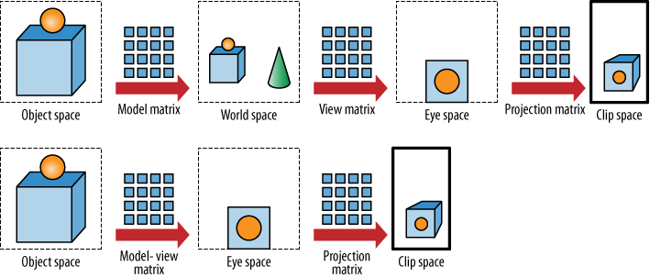
Vertex Shaders (MVP)

Slide 20
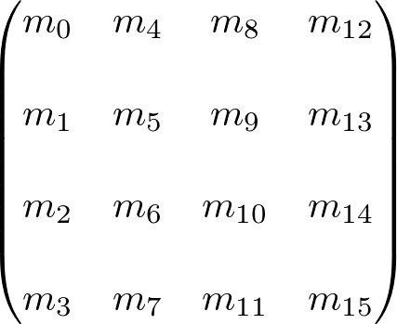
Transformation matrices (T)
Scale
Rotation
Translation
Scissors
Reflection
...
Rotate, Scale, Reflection, …
Perspective
Translation
Scale

Slide 21
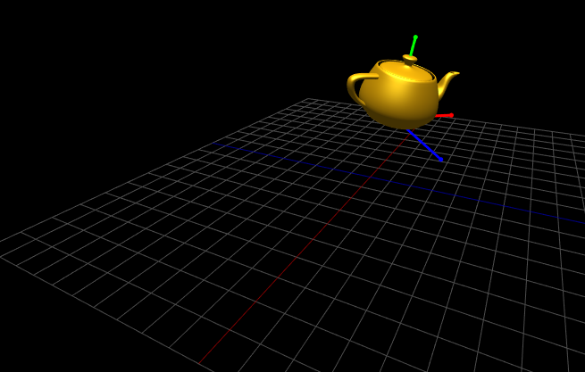
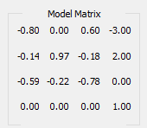
Vertex Shader – Model Transformation Matrix

Slide 22
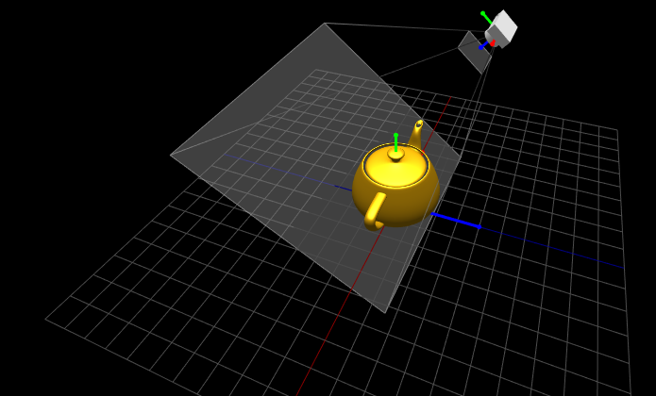
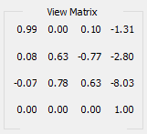
Vertex Shader – View Transformation Matrix

Slide 23
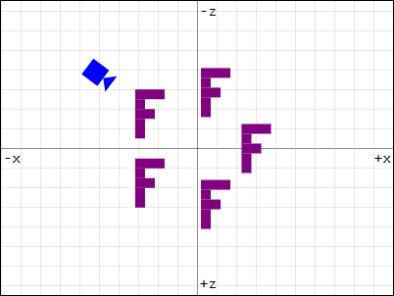
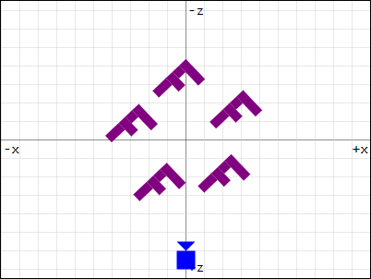
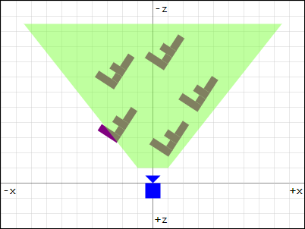
Vertex Shader – View Transformation Matrix (World transforms)
Camera (View) is fixed at Origin

Slide 24
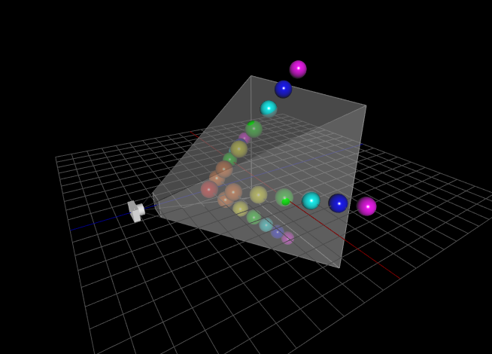
Vertex Shader – Projection Transformation Matrix
Perspective
Orthographic
…

Slide 25
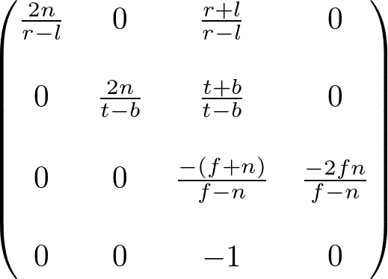
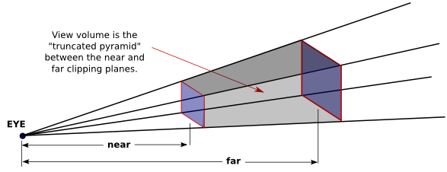
Vertex Shader – Projection Transformation Matrix(Perspective)
L: left
T: top
B: bottom
R: right
N: near
F: far

Slide 26
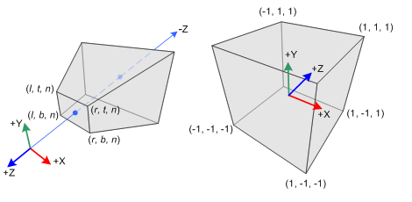
Vertex Shader – Projection Transformation Matrix

Slide 27
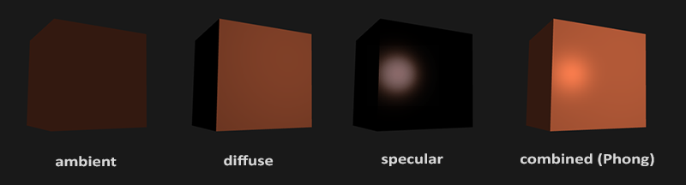

Fragment Shader - Lighting

Slide 28
Let’s Code!

Slide 29
OpenGL libraries
GL: OpenGL Core library ( rendering , drawing vertices , … ) (low level API)
GLU: OpenGL Utility library ( transforming , rotating , mathematical operations over GPU , … ) (higher level API)
GLUT: OpenGL Utility Toolkit library ( multiplatform window system interface )
GLFW: Graphics Library Frameword( multiplatform window system interface ) (Handles joysticks, keyboard, mouse, …)
SDL, FLTK, QT
WGL, CGL, GLX

Slide 30

OpenGL libraries

Slide 31
OpenGL functions (gl.h)
glVertex*(…)
glColor*(…)
glRotate*(…)
glTranslate*(…)
glScale*(…)
glBegin(…)
glEnd()
glMatrixMode(…)
glPushMatrix()
glPopMatrix()
glLoadIdentity()
glOrtho(…)
glFrustum(…)
glEnable(…)
glDisable(…)
glLight*(…)

Slide 32

OpenGL functions (gl.h)(glFrustum)

Slide 33
Any question ?

Slide 34
Resources
https://www.khronos.org/
https://www.wikipedia.org/
https://www.mesa3d.org/
https://code.tutsplus.com/
https://learnopengl.com
https://open.gl/context
http://www.songho.ca/opengl/gl_transform.html#example1
http://in2gpu.com/2015/05/13/the-model-matrix/
http://www.lighthouse3d.com/tutorials/glut-tutorial/keyboard-example-moving-around-the-world/
https://webglfundamentals.org/webgl/lessons/webgl-3d-camera.html

